Slide 1


FIT9136 PASS WEEK 2
Introduction to Python, Variables, Statements, Expressions, Functions
29th Jul 2024
CL_33 Innovation Walk, Room C107

Slide 2

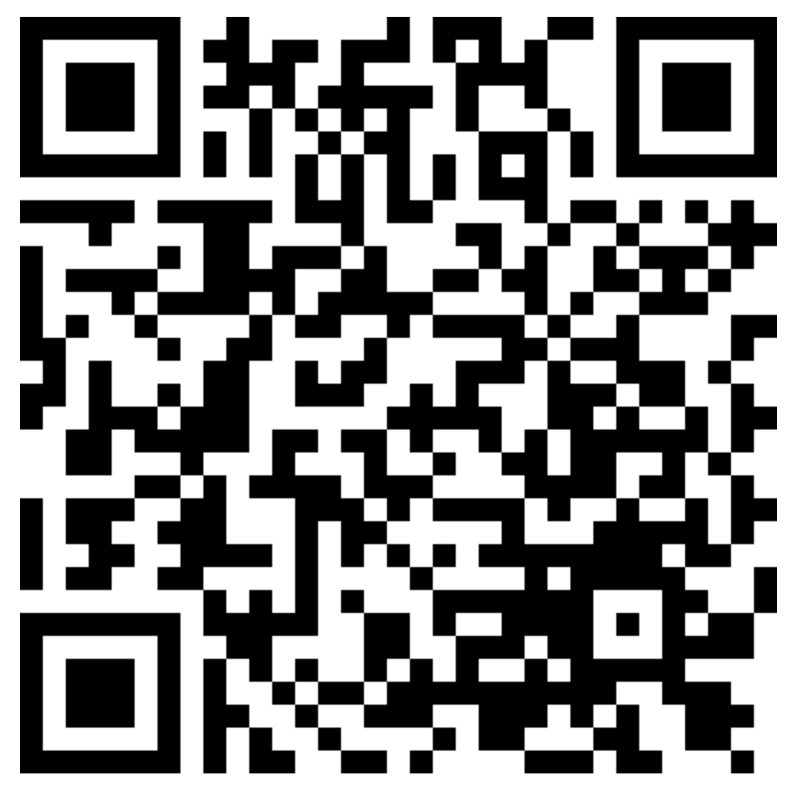
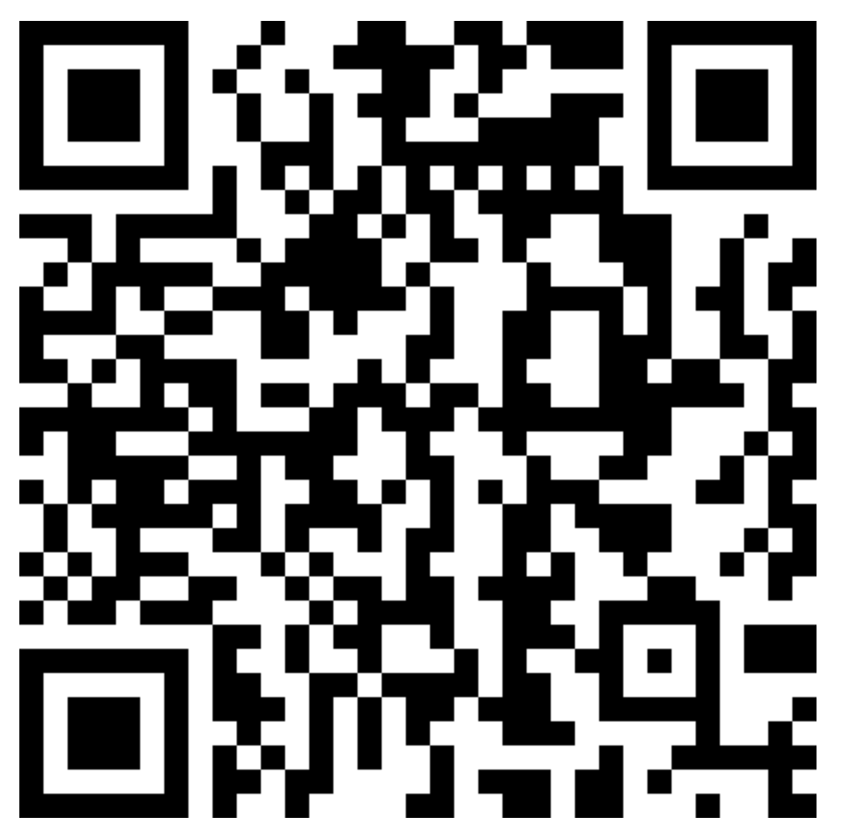
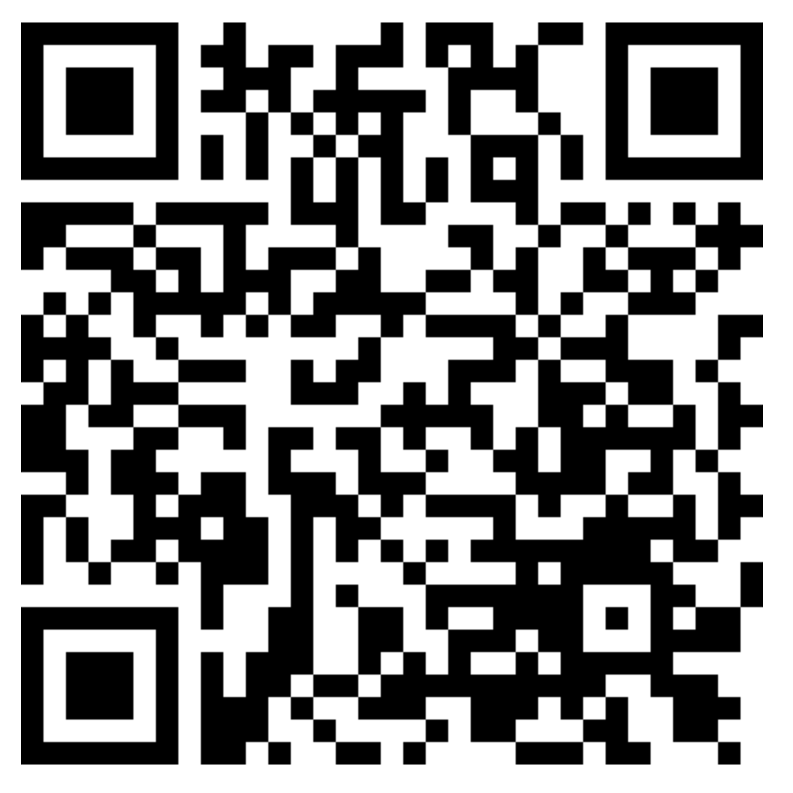

Attendance & Resources
Attending sessions is not mandatory but highly recommended.
Attendance is not assessed.
Unable to mark attendance? Email your name and student ID to harry.wang1@monash.edu
Also find the drive to receive the weekly slides: https://tinyurl.com/FIT9136-PASS
Monday 2-3pm
Tuesday 9-10am
Tuesday 4-5pm

Slide 3
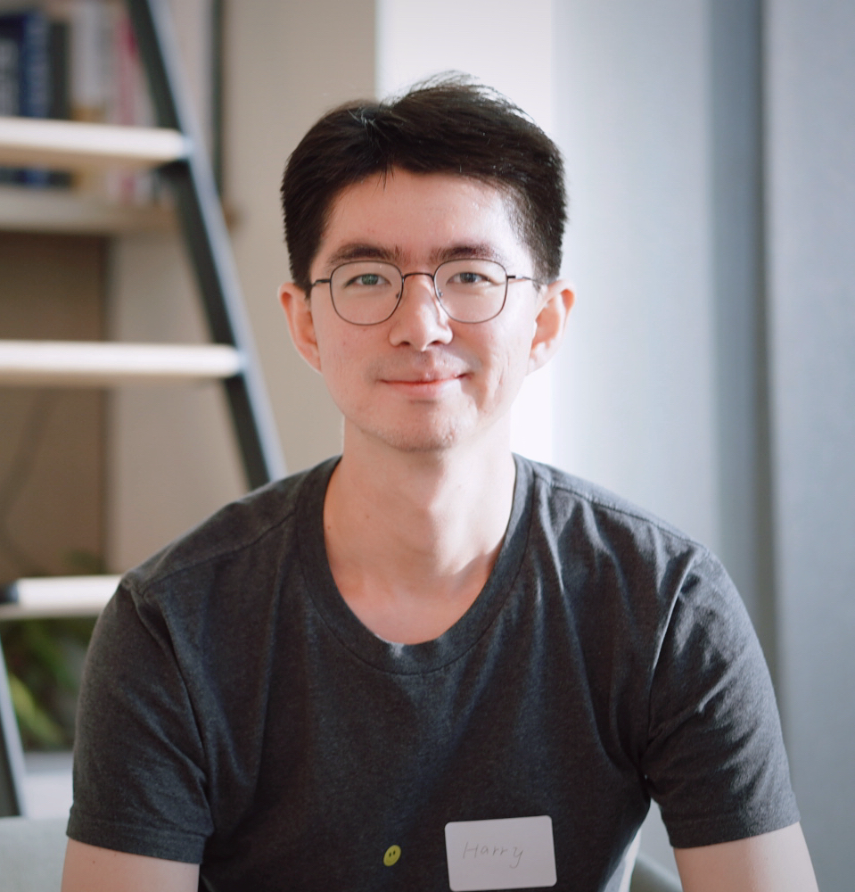
Hi 👋 I am Harry!
I am your PASS leader for FIT9136.
A little about me:
Master of Information Technology - final semester
Interested in coding and logical thinking
Chill & Honest 🤗
Welcome to questions 🥳

Slide 4
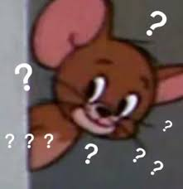
Little About You
Activity - Your turn for the show~~
What is your name?
Do you like programming? Why?
Do you have a background of coding before?

Slide 5

Agenda
01
Materials Recap (25%)
Quick review for last week’s materials, and pick up Keywords for weekly practice
02
Practice (70%)
Highly related to teaching materials, most are code challenges.
03
Closure speaking (5%)
Attendance recording and survey

Slide 6


Before We Go
Learning Strategy - Problem Solving !!!
Programming Language is just a Tool
The way we use the language matters.
Python

Slide 7
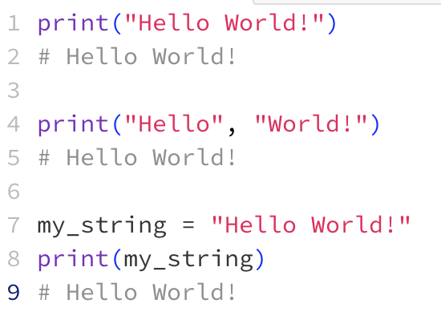
Revision - Week 1
Print
Used to display something to the console.
Main method of getting information from the program to the user.
Can be used for debugging.

Slide 8
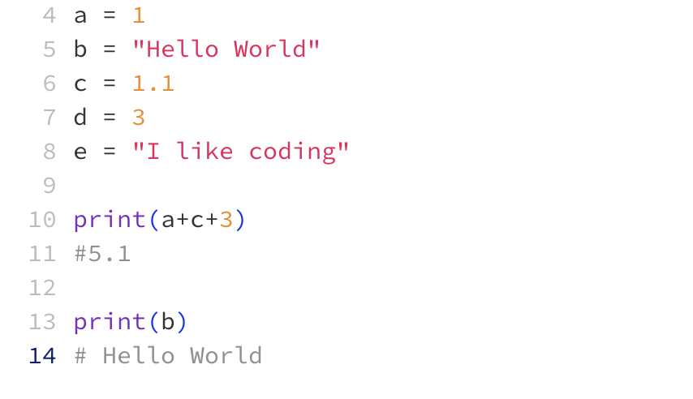
Revision - Week 1
Variables
Variables can store data of different types.
Provide dynamic manipulation while handling expressions and passing data to functions

Slide 9
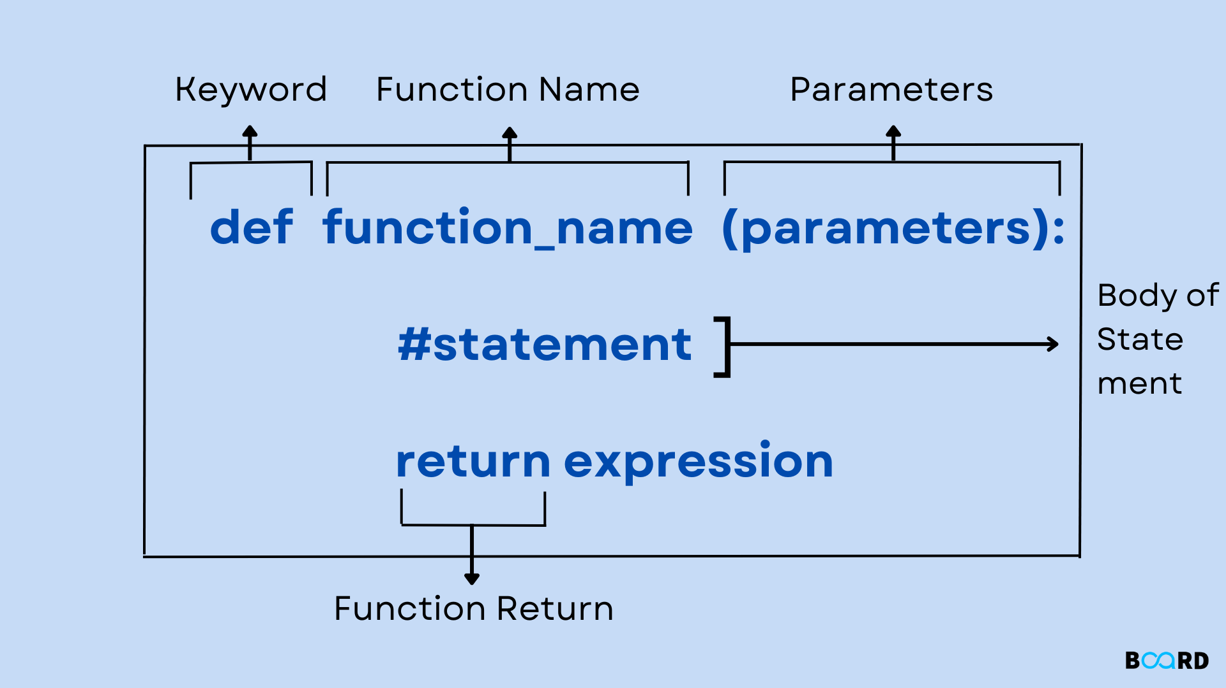
Revision - Week 1
Functions In Python, function is a group of statements that perform a certain task.

Slide 10
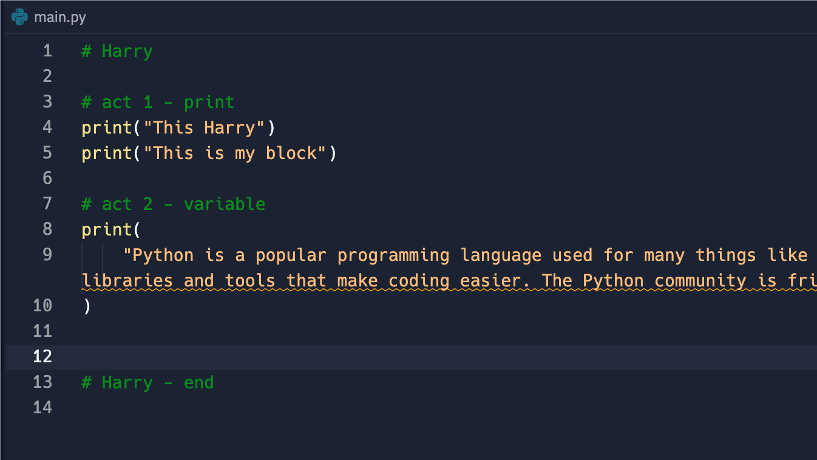
Activity 1 - Print it 💻
Join the Coding Platform: https://tinyurl.com/pass-coding
Create your own block:
Add a comment with your name to an empty line, and add an endpoint at the end of your block
Print something you want to say to your mates (a bio? story? greeting? whatever~~)
Remember to use several prints plz
Run the code and see what will happen

Slide 11
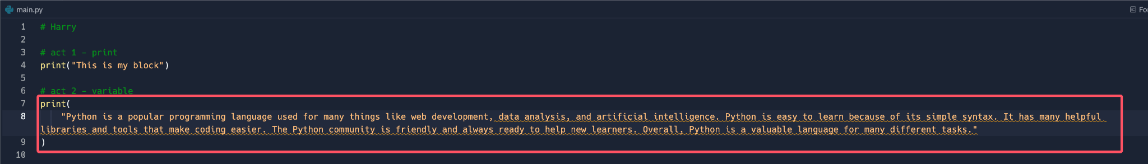
Activity 2 - Change it 🛠️
Find the code in Harry’s block, copy and paste it to your area:
Tasks:
Find the word “Python” and change them to “Java”
Find the word “Java” and change them to “JavaScript”
Find the word “JavaScript” and change them to “PHP”
Find the word “PHP” and change them …
Find the word …
You’re tired?
So, another way? 🧐🧐🧐

Slide 12

Activity 3 - Pack them up 🧳
Think about it:
How do you share your code in activity 1 to others? Copy and Paste?
Tasks:
Now you need to run your deskmate’s code used in activity 1
Collaborate with each other and ask for their code
Run their code in your block.
How would you do this 🧐🧐🧐
Copy and Paste???

Slide 13
Activity 4 - Final challenge
Problem:
You are tasked with creating a simple inventory management system for a small bookstore. The bookstore needs a function to update the stock of books whenever a new shipment arrives. The function should take the current stock and the number of new books as input, update the stock, print out a message indicating the update, and return the updated stock.
A bookstore management system
Update the stock, when new shipment comes
Print out the updated stock
Return the updated stock
Solution: ?
Tips:
Naming convention
Use function
Use variables
Use print

Slide 14
Closure Speaking
Unable to mark attendance? Email your name and student ID to harry.wang1@monash.edu
Also find the drive to receive the weekly materials: https://tinyurl.com/FIT9136-PASS
Monday 2-3pm
Tuesday 9-10am
Tuesday 4-5pm

Slide 15
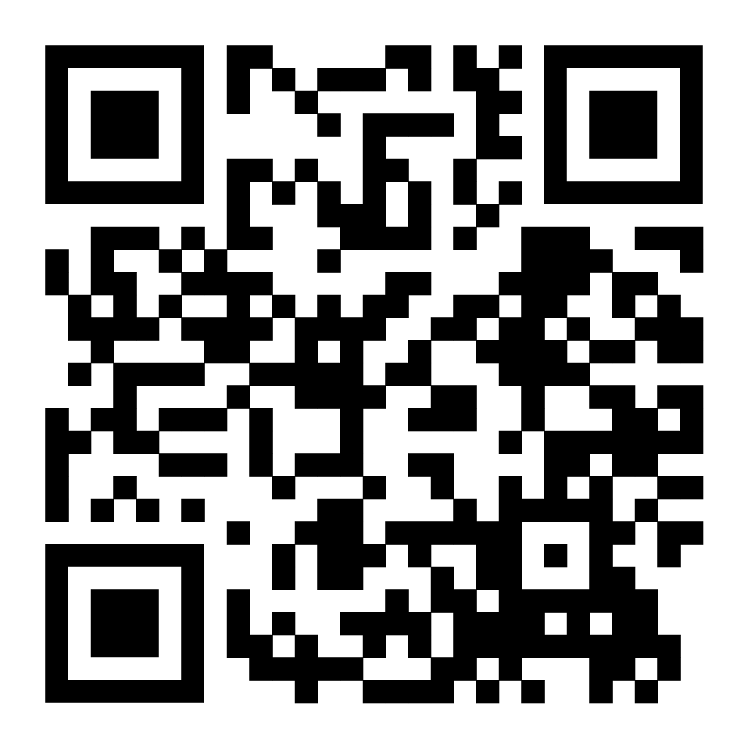
Closure Speaking
Complete the Beginner survey: https://tinyurl.com/survey-PASS

Slide 16
Thank You
29th Jul 2024
CL_33 Innovation Walk, Room C107

Slide 17
Questions & Answers
29th Jul 2024
CL_33 Innovation Walk, Room C107

